Slide 1

NATIONAL SCHOLARSHIP PORTAL
ACADEMIC YEAR 2025-2026
Presented By:
Seeramsetti Bhagya Sree
Reddypalli Manisha
Nandyala Likhitha
Guided By : Mr. Arvind Kumar

Slide 2
INTRODUCTION
The National Scholarship Portal (NSP) is a web-based application developed to automate and simplify the scholarship application, verification, and approval process for students, institutions, and government authorities.
The system ensures transparency, security, and efficiency in managing scholarships for eligible students at various educational levels.
This portal acts as a single integrated platform connecting students, institutes, state officers, and ministry administrators — allowing them to manage the complete scholarship lifecycle online.
Technologies used:
•Frontend: HTML, CSS, Bootstrap, Razor Views
•Backend: ASP.NET Core MVC
•Database: SQL Server with Entity Framework Core
•Language: C#
•Tools: Visual Studio 2022

Slide 3
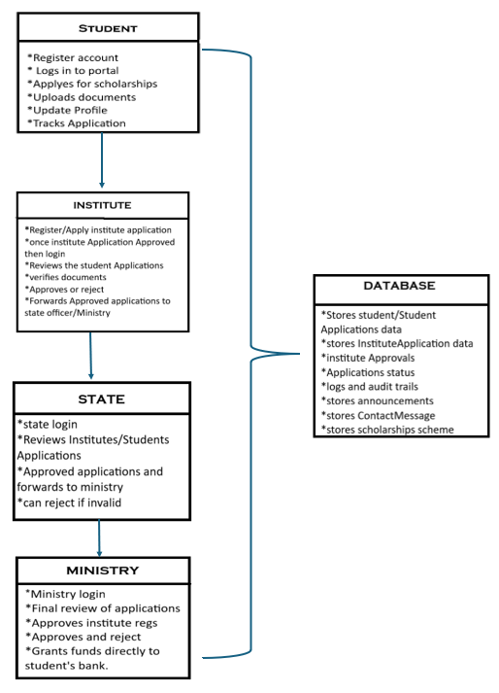
Flowchart

Slide 4
CONTENTS
Home Page
Admin/Announcements
FAQ
Contact us
chatbot
Student login
Student Dashboard
Scholarship Application
My profile
Institute Registration
Institute Login
Institute Dashboard
Institute Student Application
Institute Profile
State Login
State dashboard
Institute Applications
Student Applications
Ministry Login
Ministry dashboard
Institute Applications
Student Applications

Slide 5
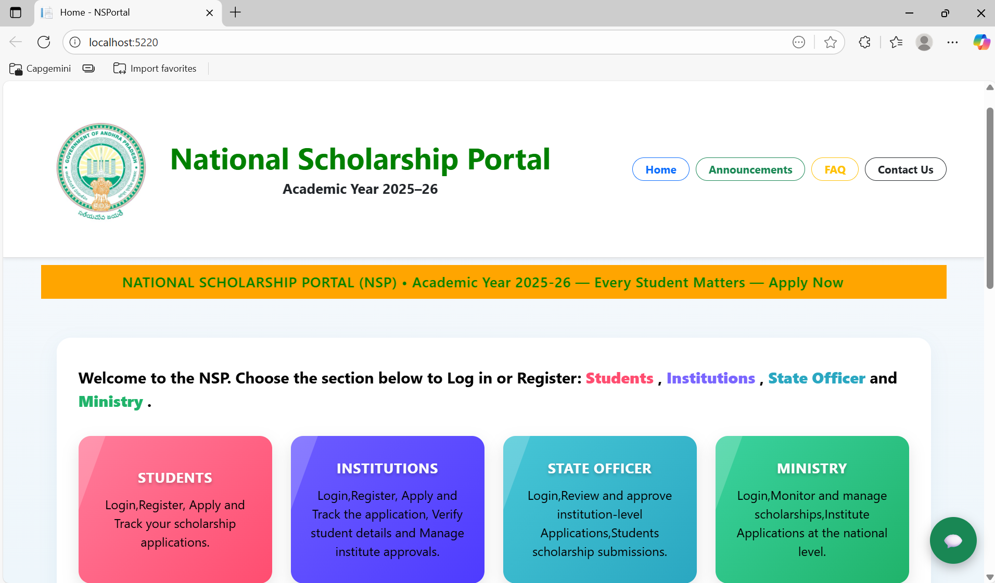
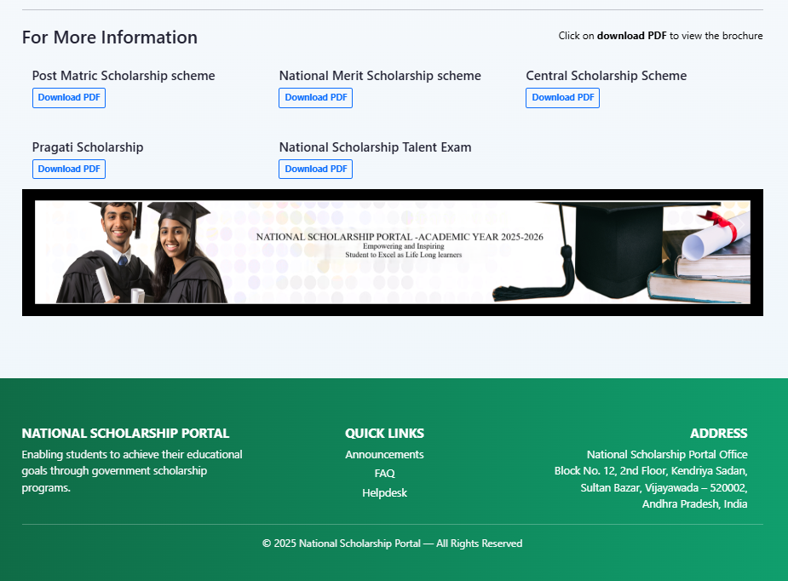
HOME PAGE
The Home Page of the National Scholarship Portal (NSP) provides an overview of the platform and acts as the main entry point for users. It allows students, institutes, states, and ministries to access their respective login pages. The page highlights the portal’s purpose — to simplify and streamline the scholarship application process — and provides easy navigation to all key sections like Login, Registration, and Guidelines.

Slide 6
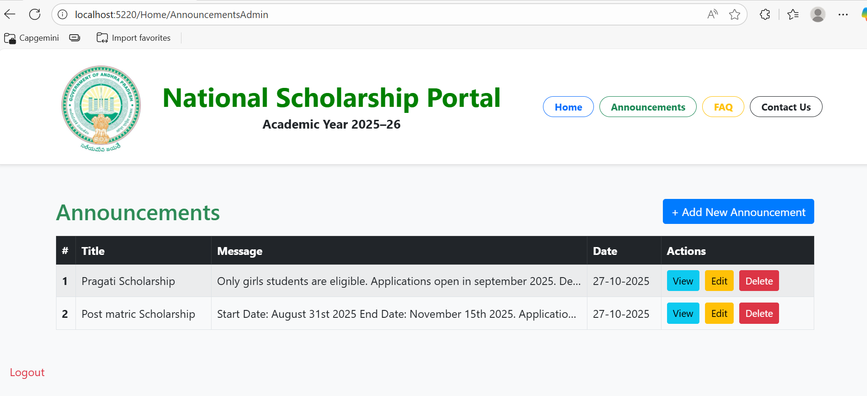
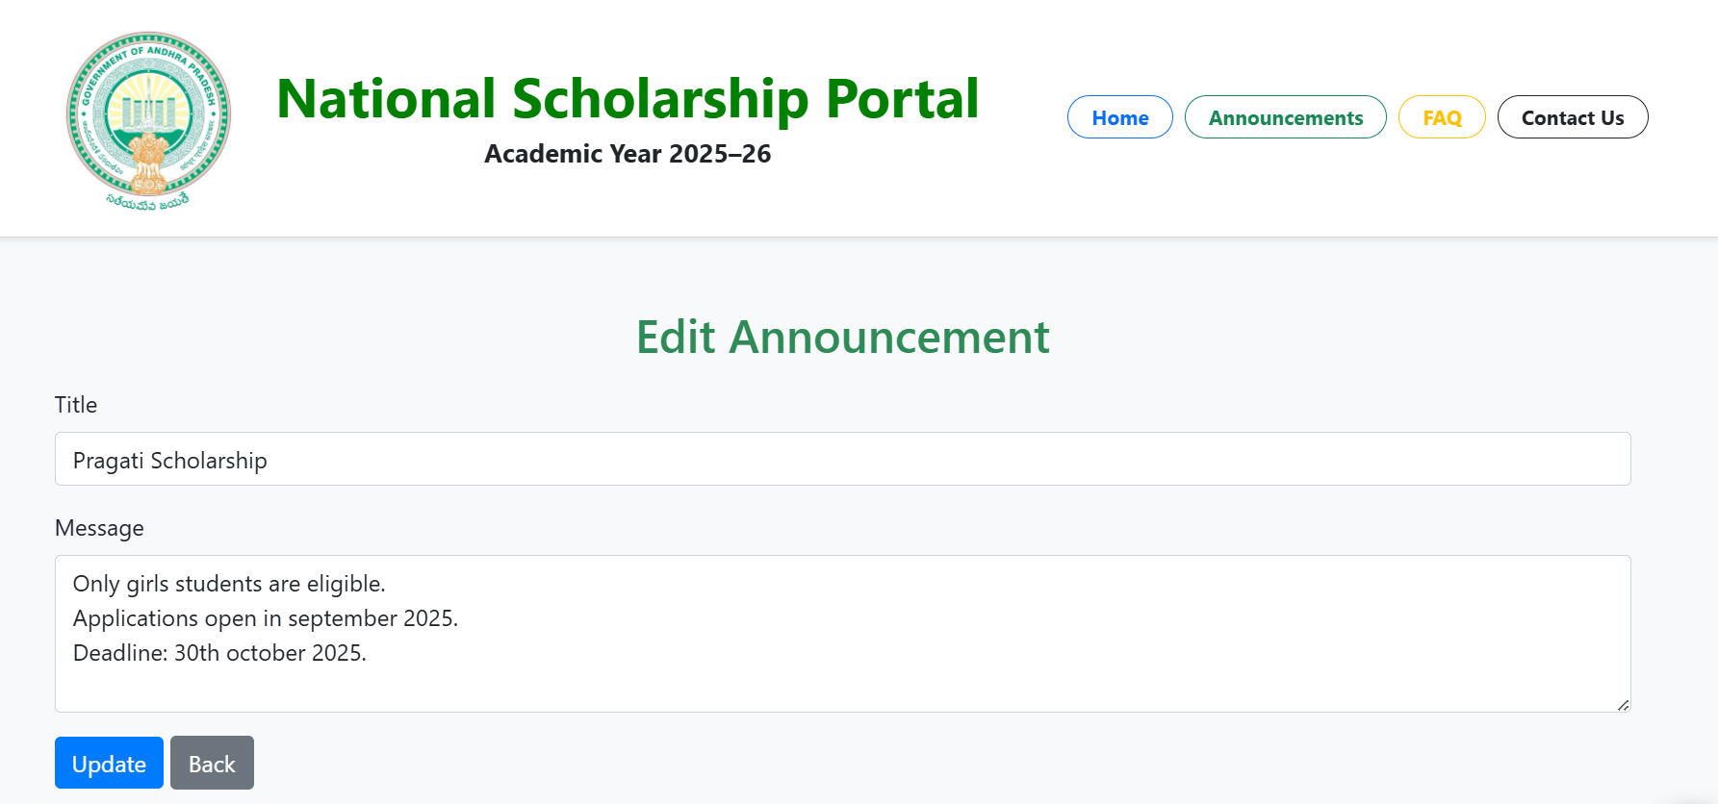
ADMIN LOGIN/ANNOUNCEMENTS
Fig: Announcements dashboard(Add new ,view ,edit ,delete Announcements.
Fig: Edit Announcement(Update/Back)

Slide 7
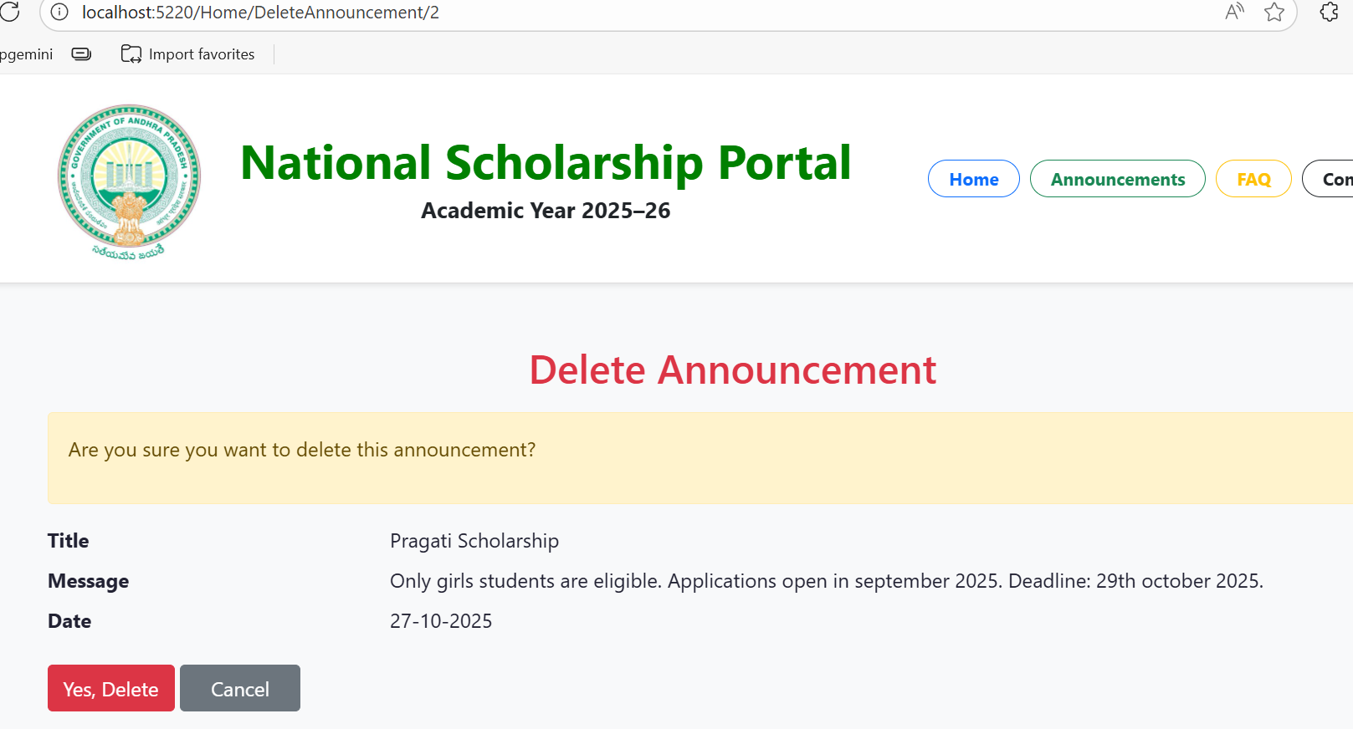
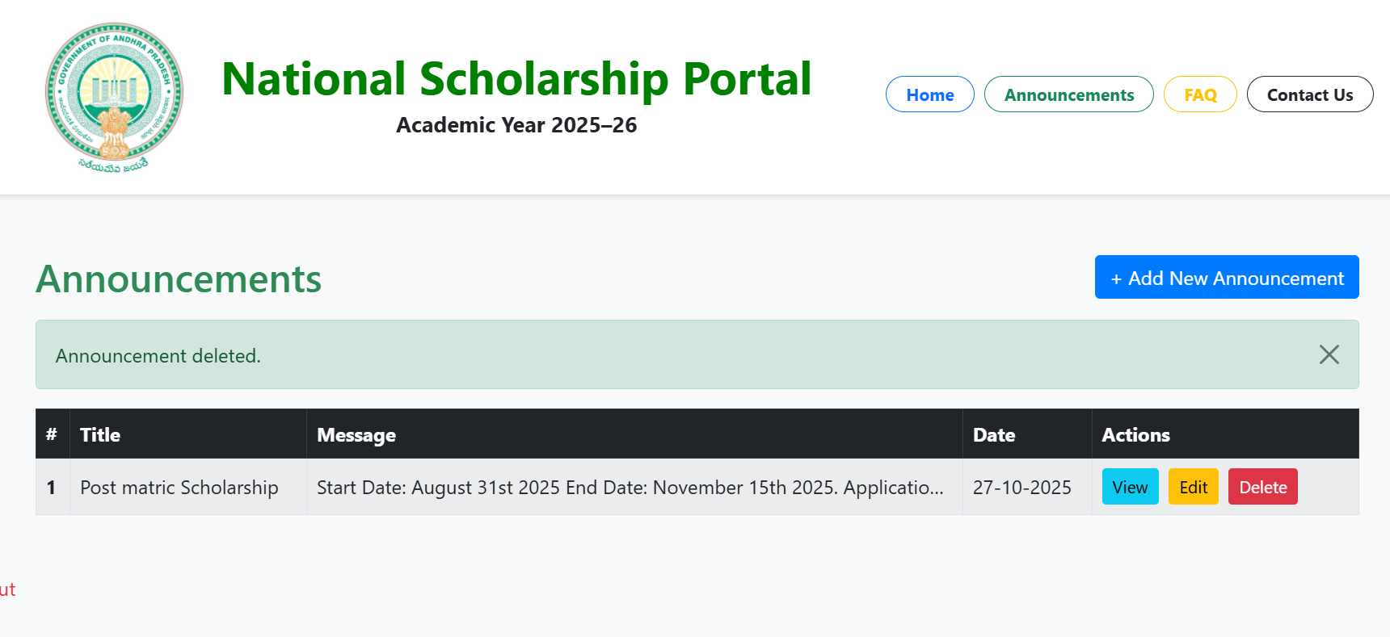
Fig: Delete Announcement(yes ,Delete → Pop up(Are you sure want to delete)/cancel)

Slide 8
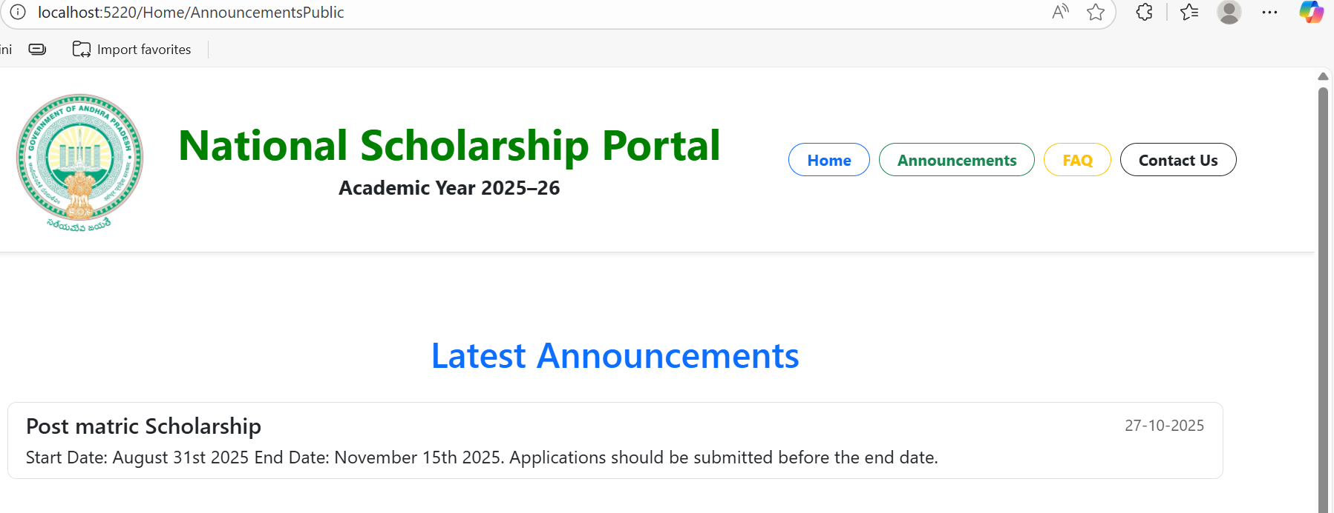
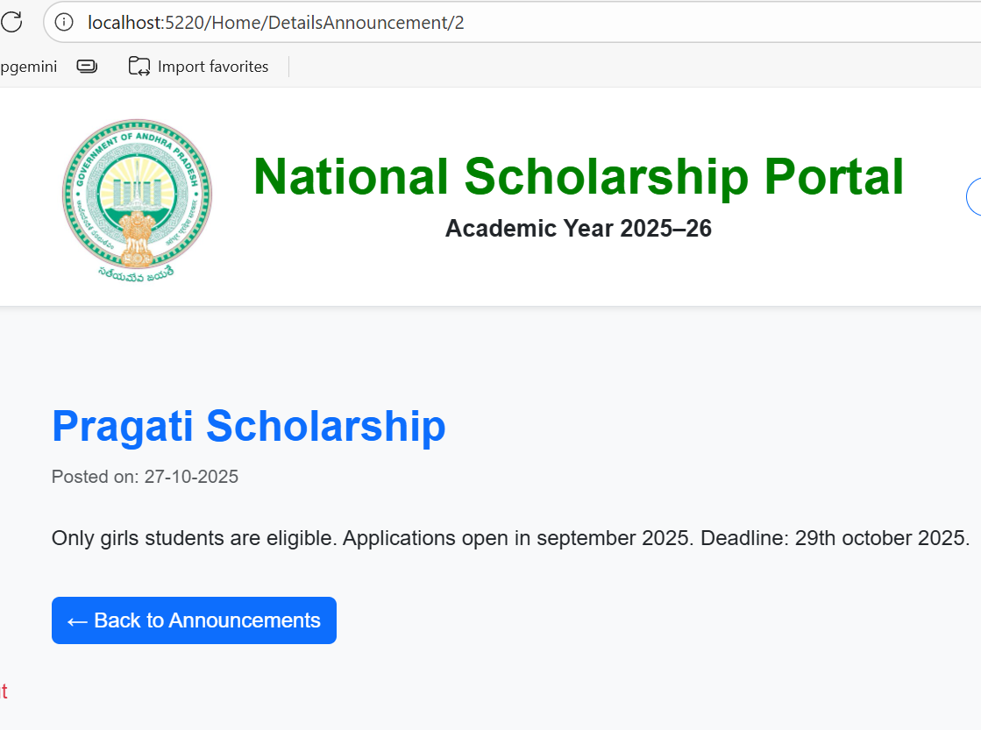
Fig: View Announcement
Fig: Latest Announcement Public

Slide 9
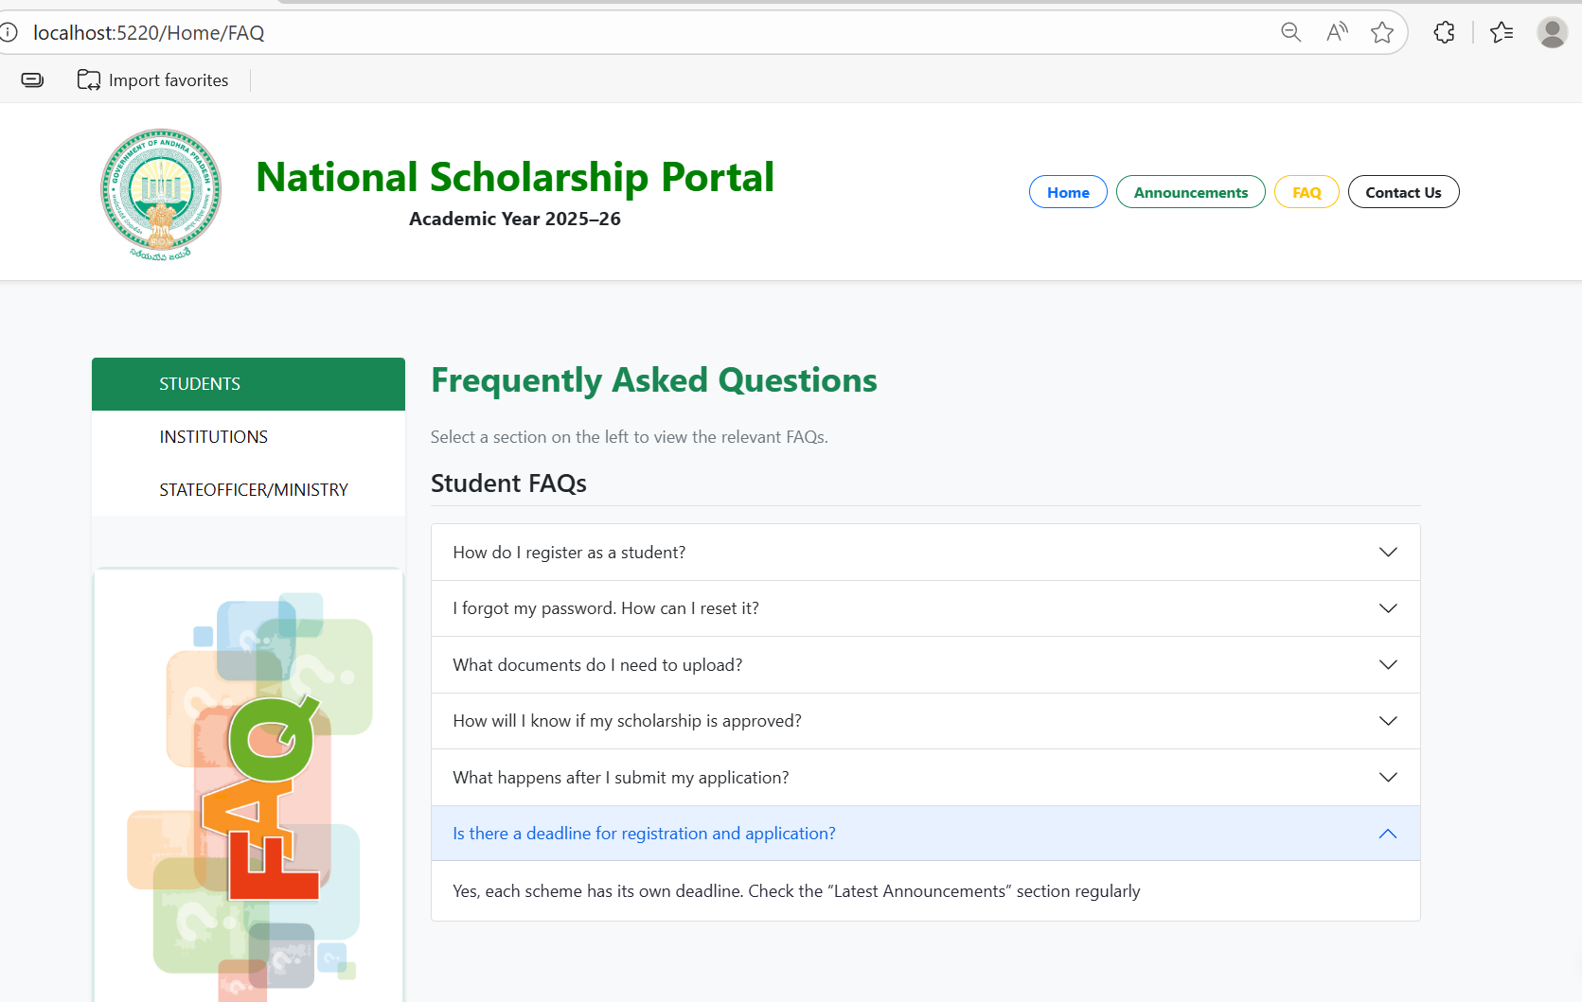
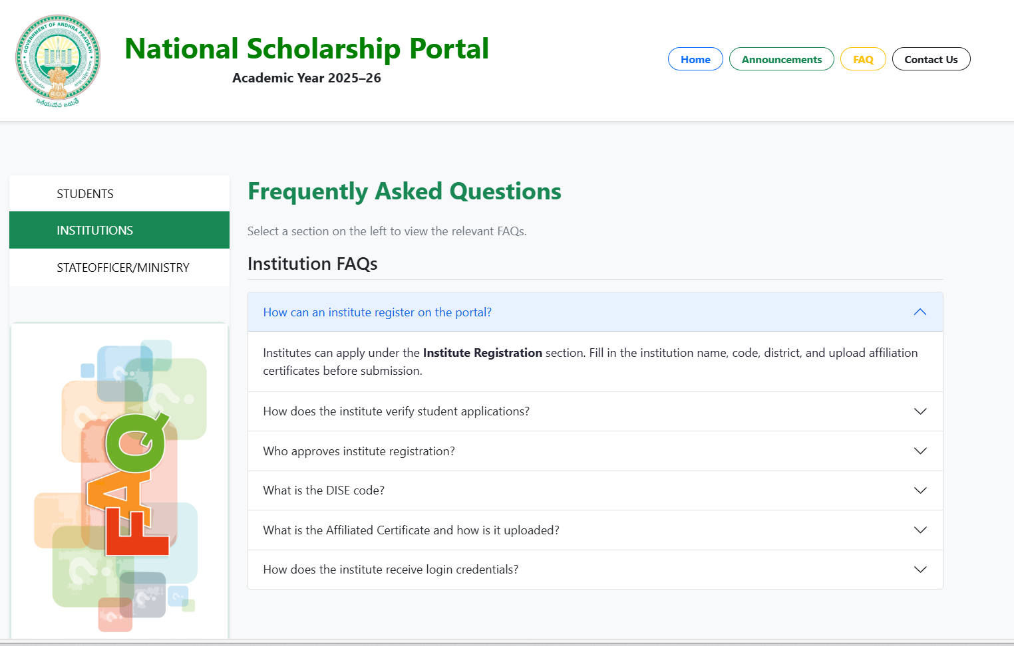
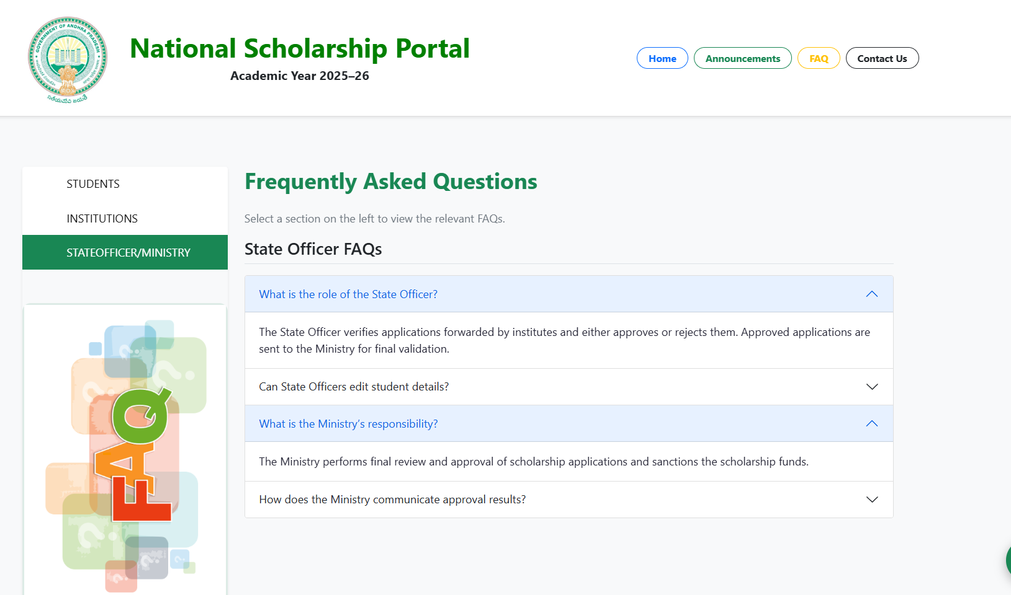
FAQ
Fig: FAQ-Students ,institute ,State officer/Ministry

Slide 10
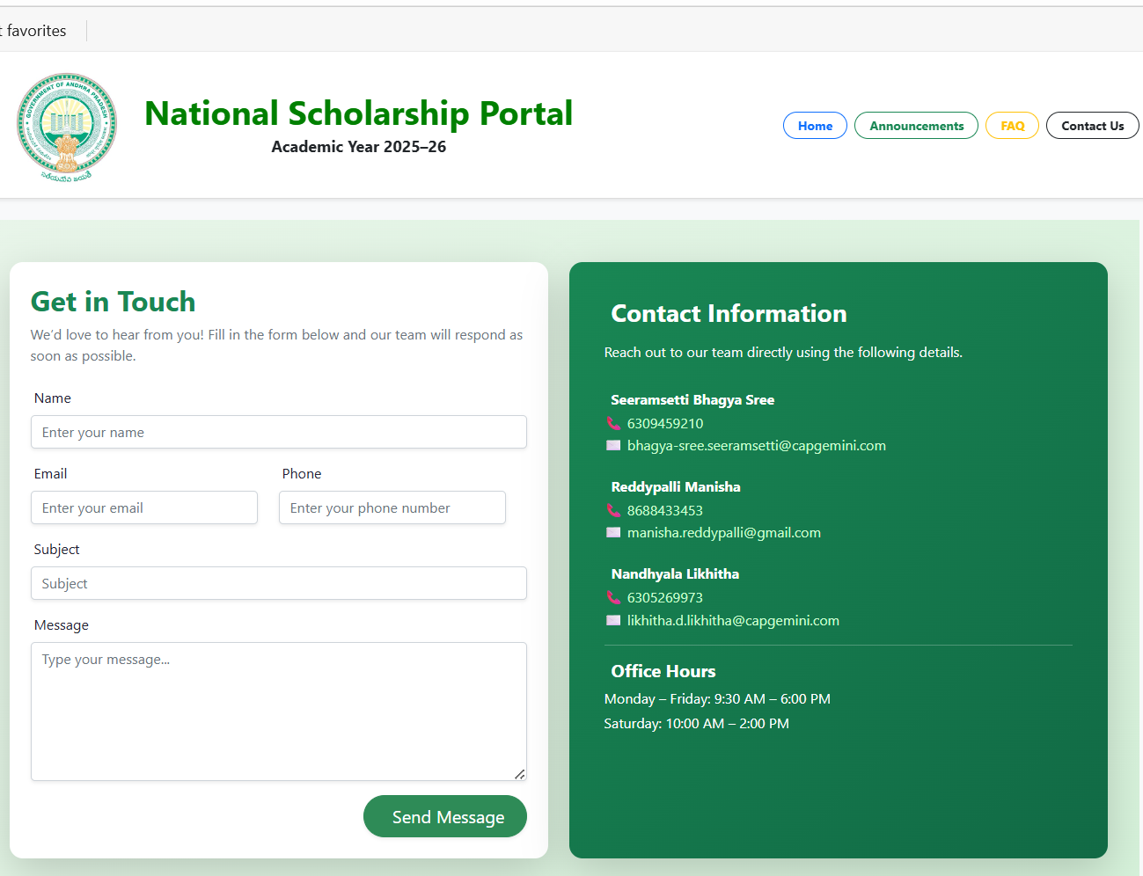
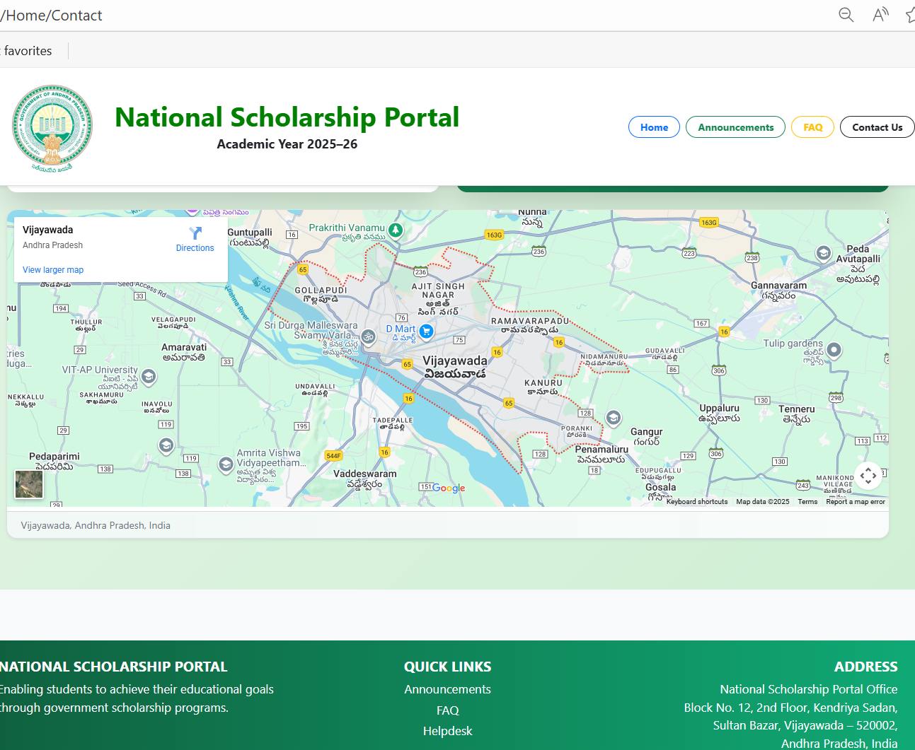
CONTACT US

Slide 11
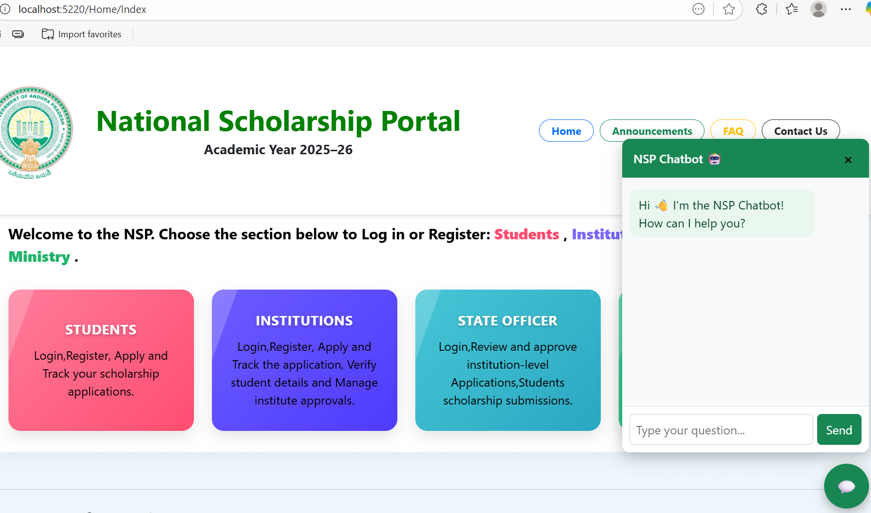
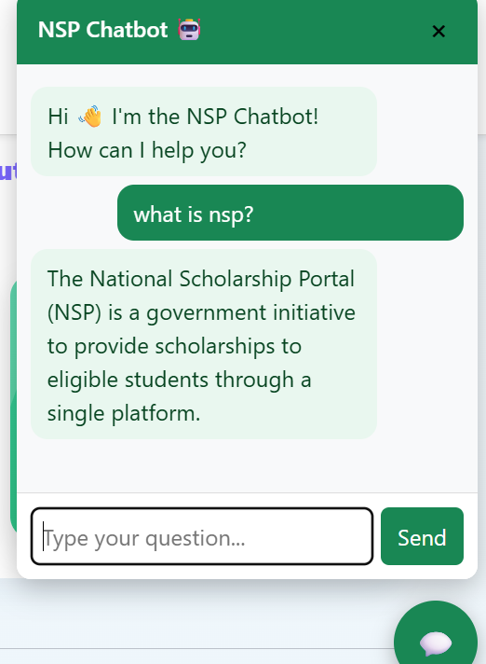
CHATBOT

Slide 12
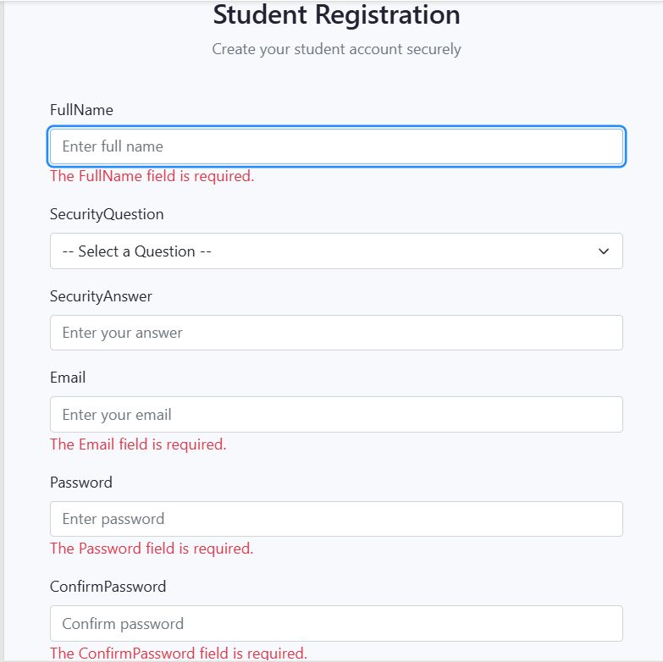
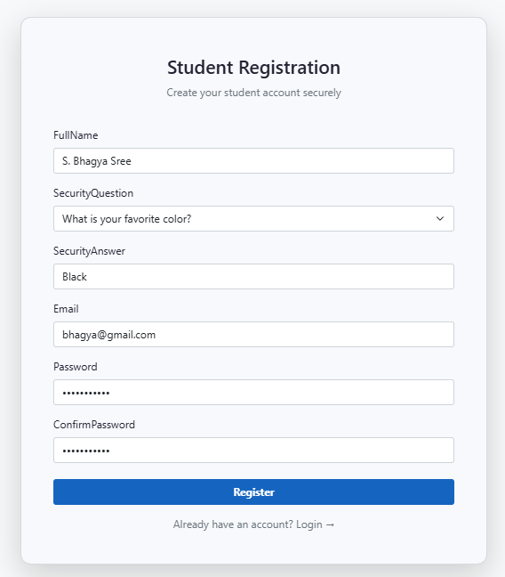
STUDENT REGISTRATION
Fig: Validation errors
Fig: Successful Registration

Slide 13
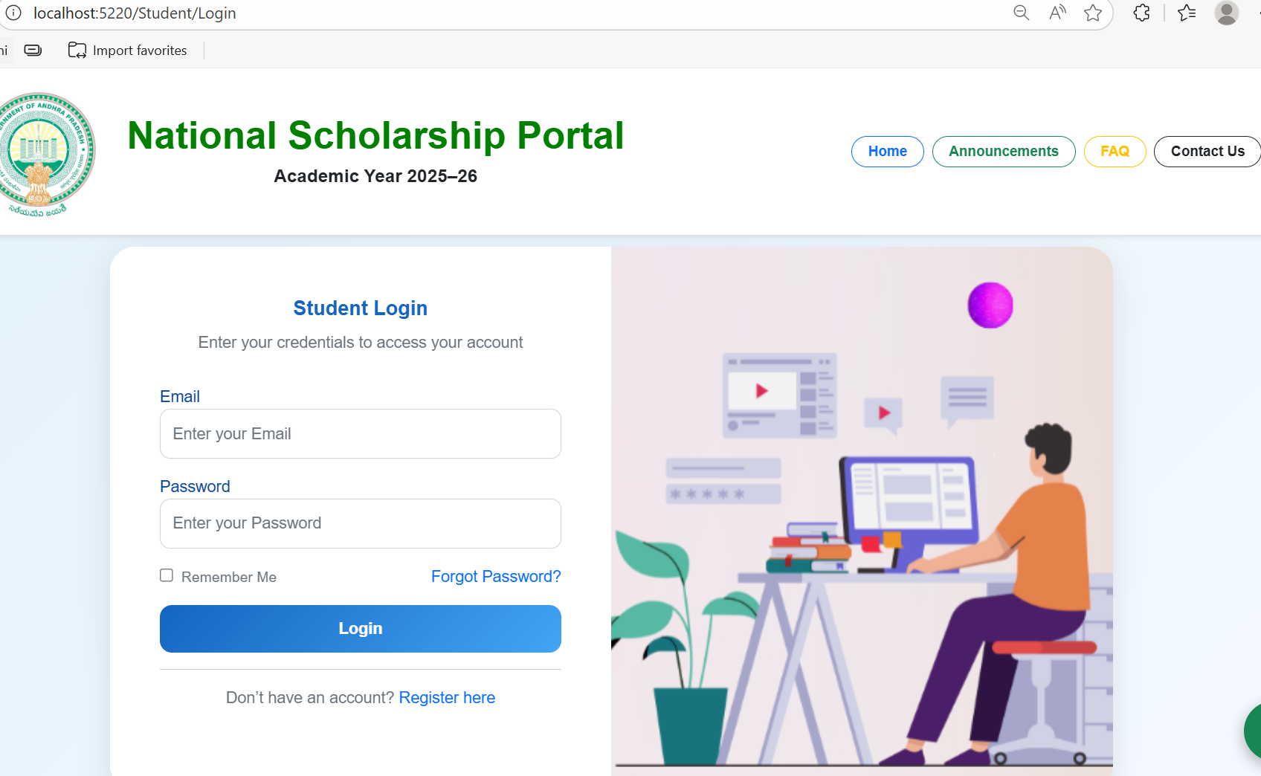
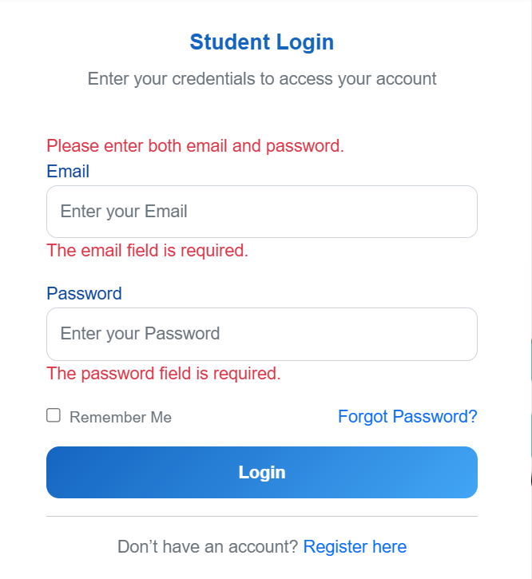
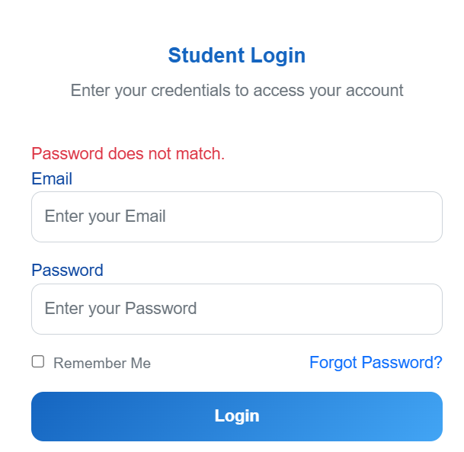
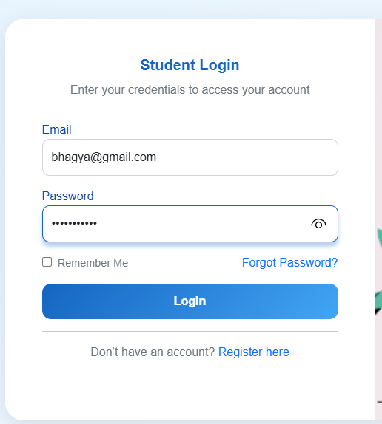
STUDENT LOGIN
Fig: Successful Registration
Fig: Validations Errors

Slide 14

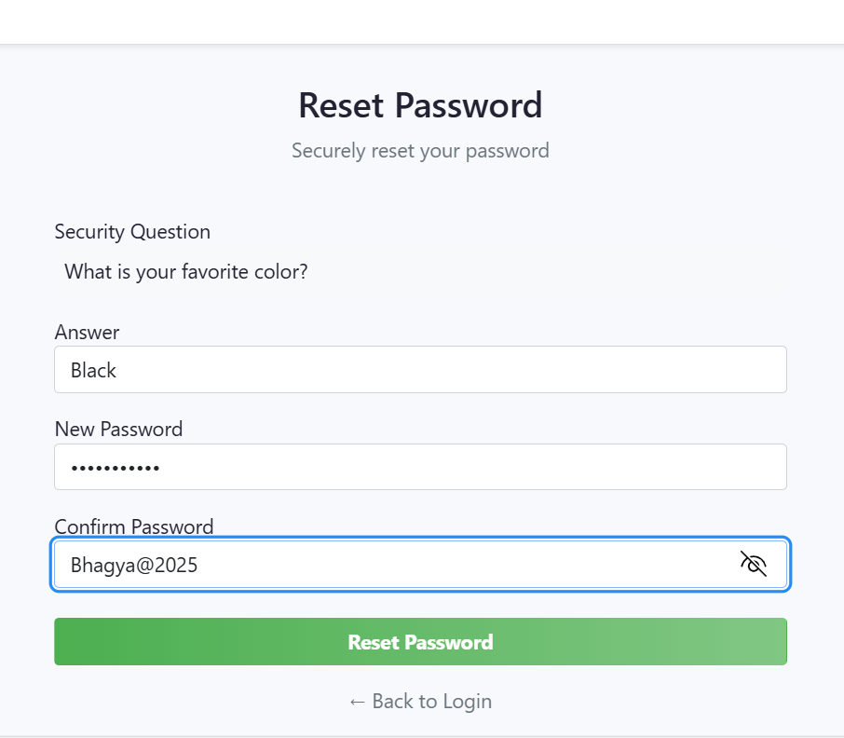
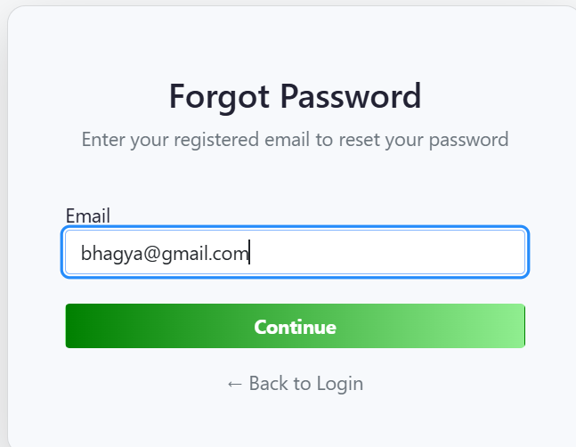
FORGOT /RESET PASSWORD
Fig: After Verification via email
Fig: Redirects to reset page

Slide 15
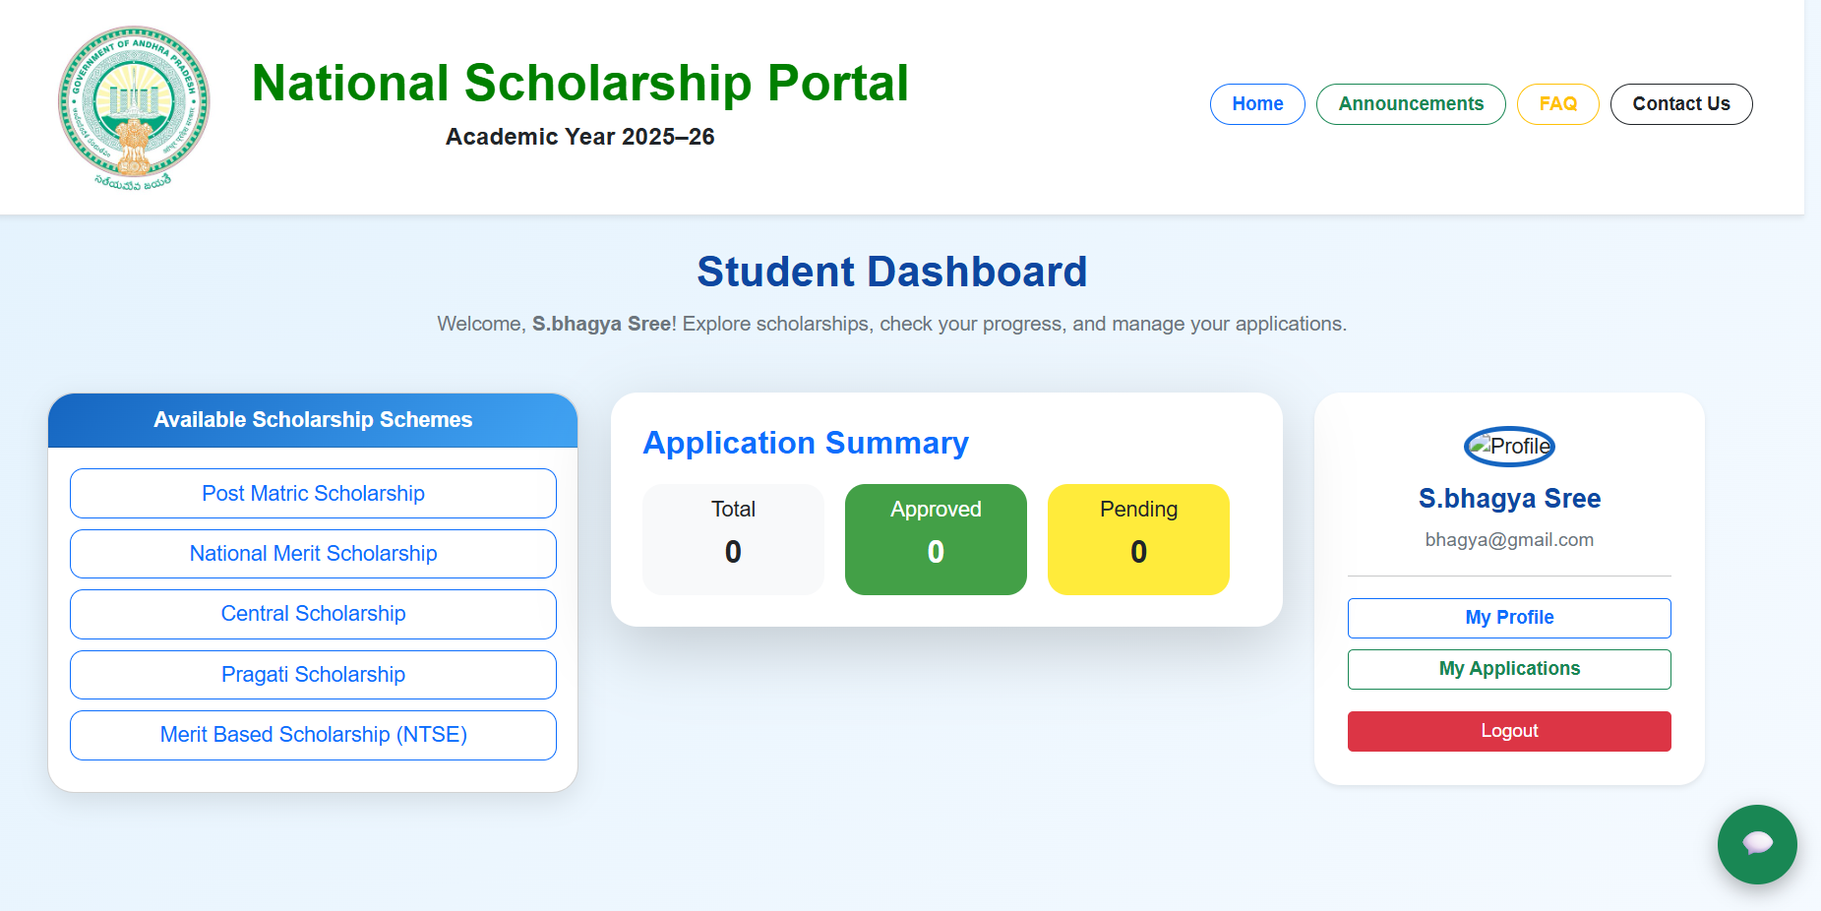
STUDENT DASHBOARD
Dashboard acts as home page for student after login. It provides easy navigation to different modules like My Applications, Scholarship Applications, and Profile.

Slide 16
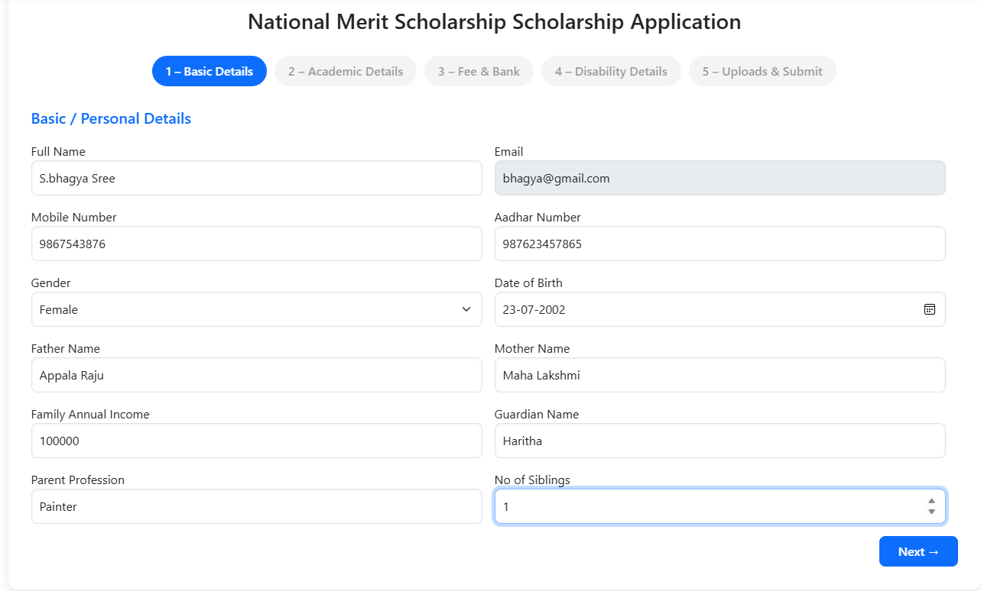
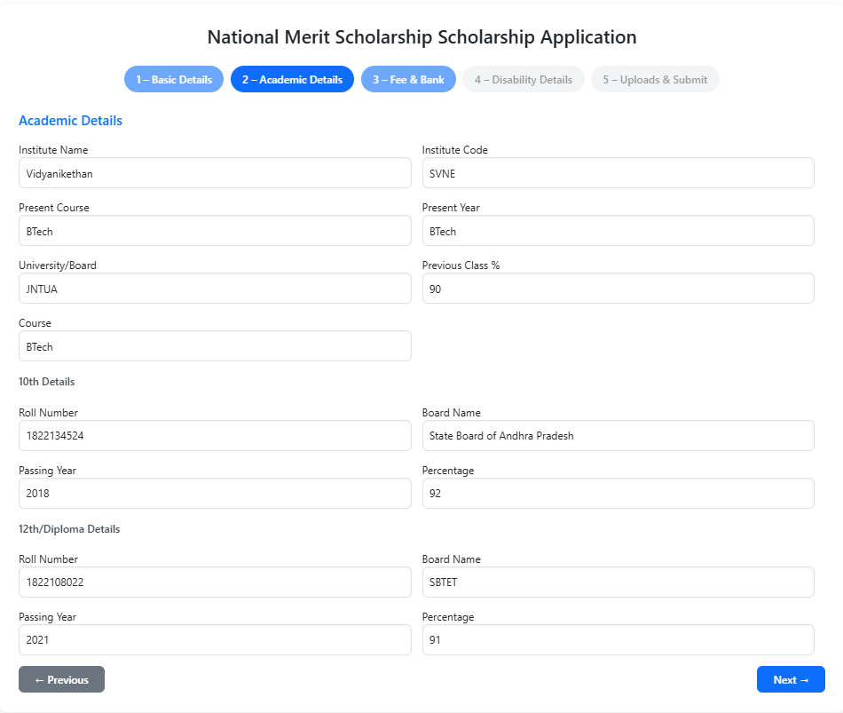
APPLYING FOR SCHOLARSHIP
Select Scholarship
Fill details

Slide 17
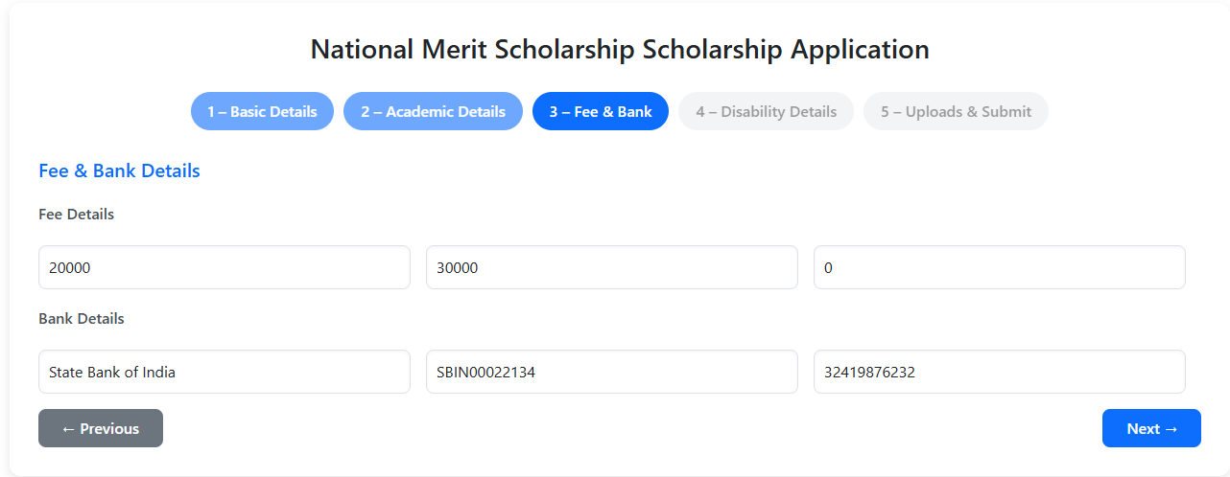
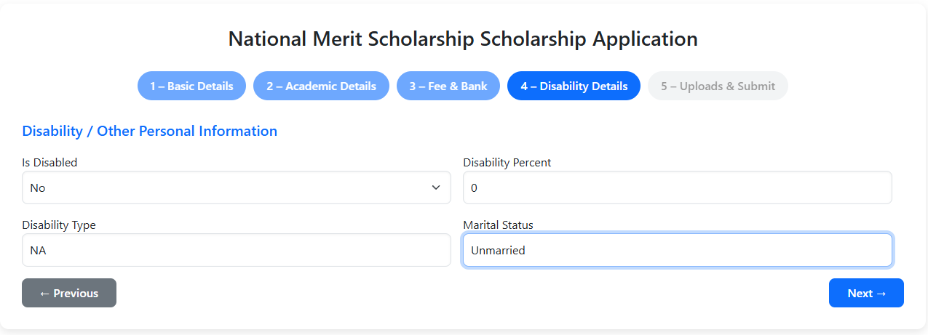
APPLYING FOR SCHOLARSHIP
Fill Details

Slide 18
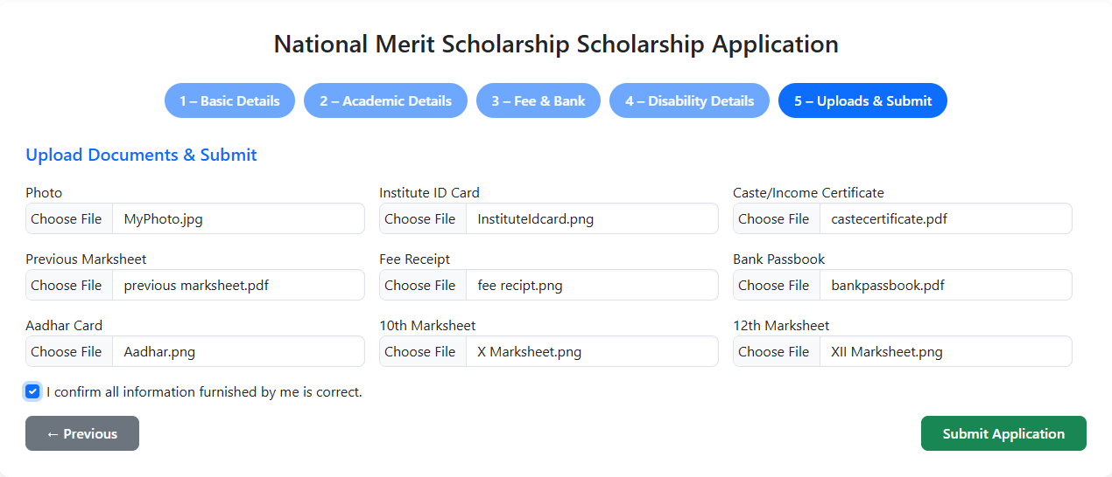
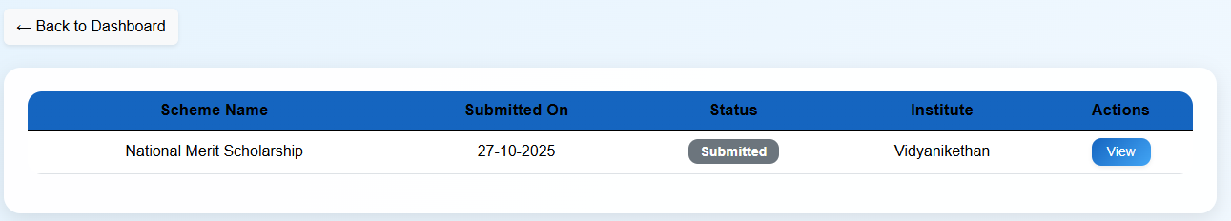
APPLYING FOR SCHOLARSHIP
Upload Documents → Submit Application
Fig: My Applications

Slide 19
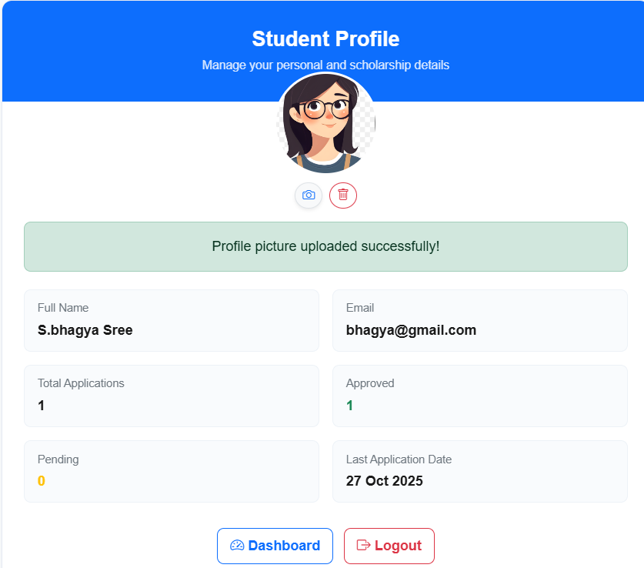
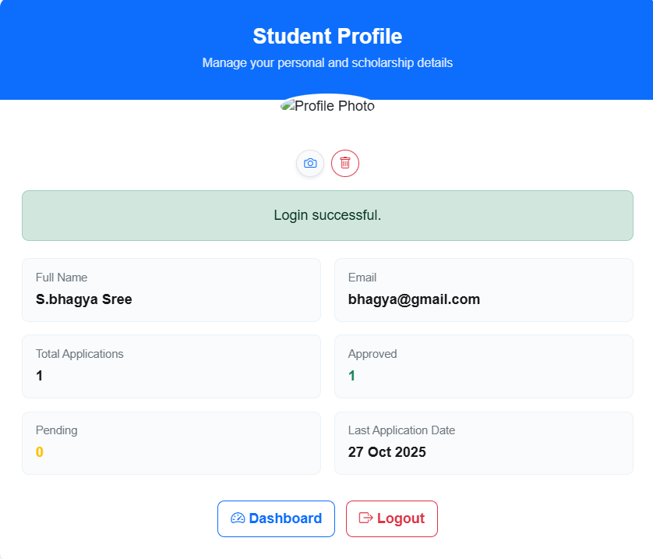
STUDENT PROFILE
Fig: Profile Picture upload
Fig: Student Profile page

Slide 20
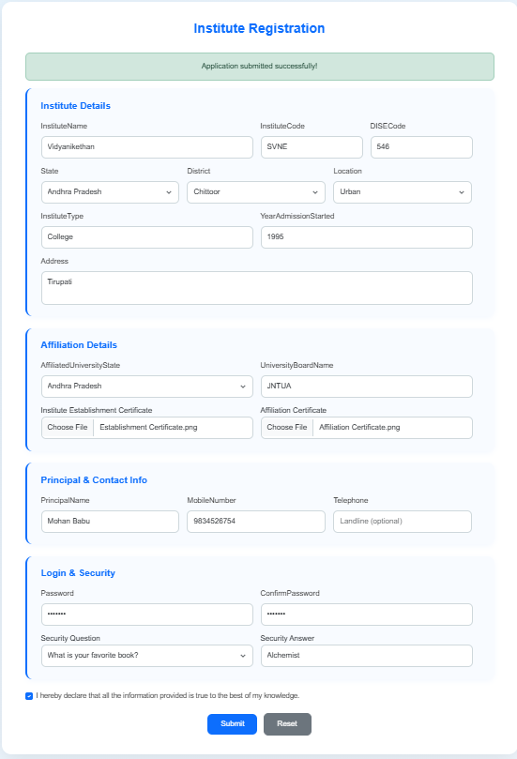
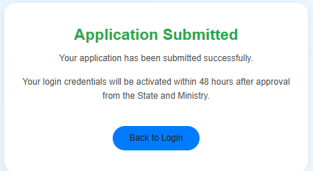
INSTITUTE REGISTRATION
Institute fills form → Validates → Registration Success → login Access Granted

Slide 21
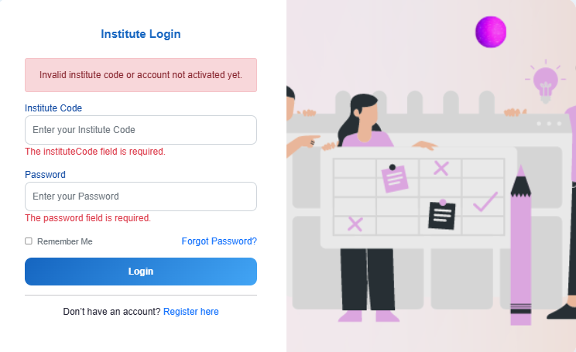
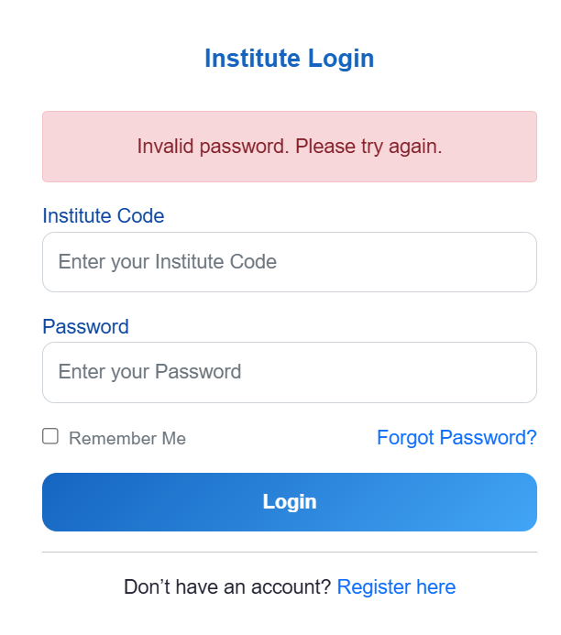
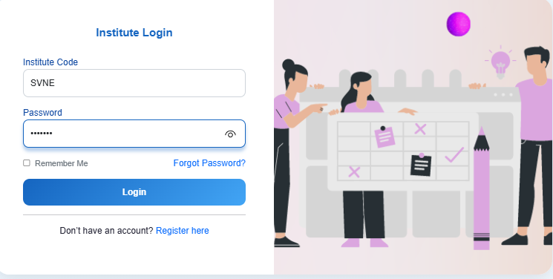
INSTITUTE LOGIN
Validations Errors
Successful Registration

Slide 22
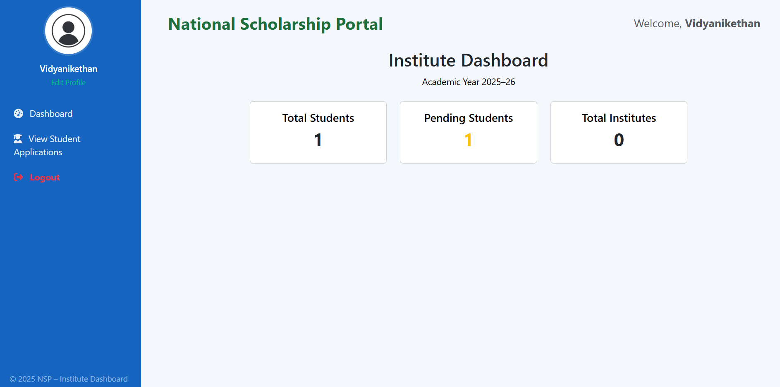
INSTITUTE DASHBOARD
The Institute Dashboard allows institutes to view and manage student applications submitted under their institution. From this page, institutes can verify student details, approve or reject applications, and forward the verified ones to the state level. It provides an organized view of application status and ensures smooth processing of scholarship requests.

Slide 23
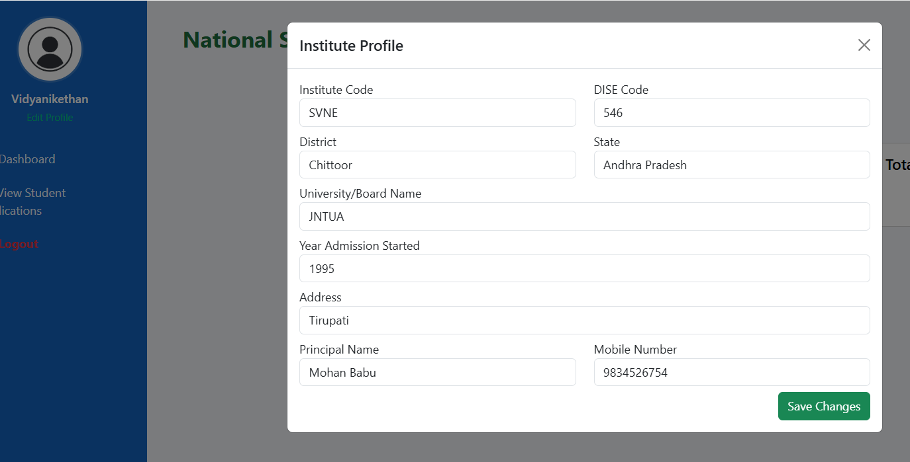
INSTITUTE PROFILE
The Institute Profile page contains complete details about the registered institute, including its name, code, address, contact information, and head of the institution details. It allows institutes to update or manage their information and ensures accurate identification during the scholarship verification process. This section helps maintain transparency and proper record management within the portal.

Slide 24
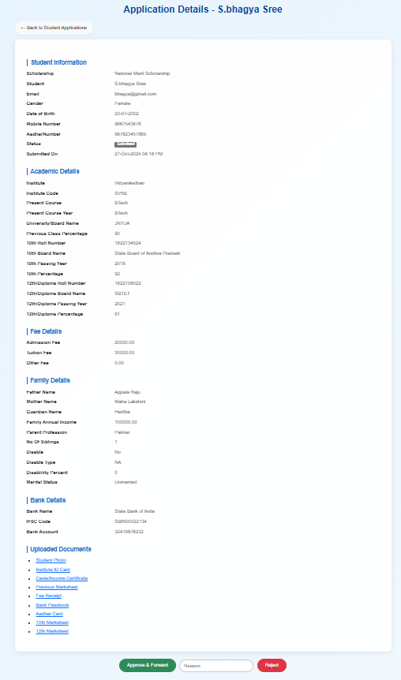
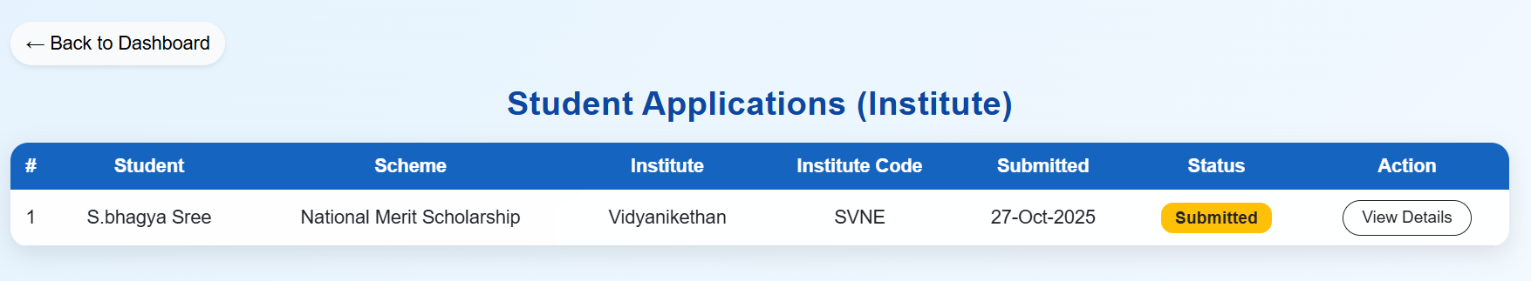
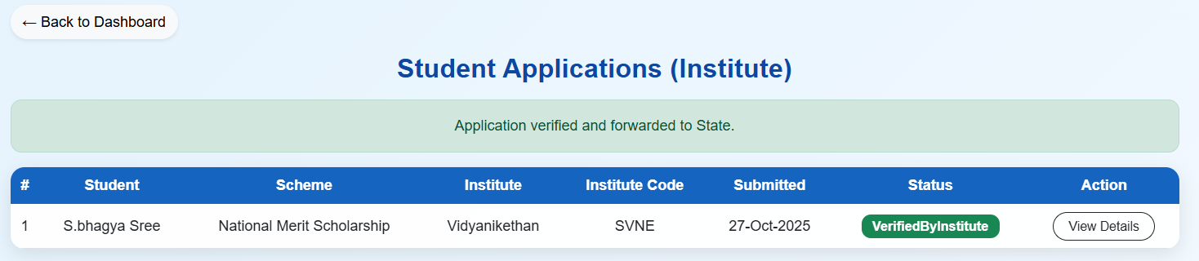
INSTITUTE STUDENT APPLICATIONS
Institute can view details of student , able to approve or reject. Forward to higher officer's.
Fig: Student Application Details

Slide 25
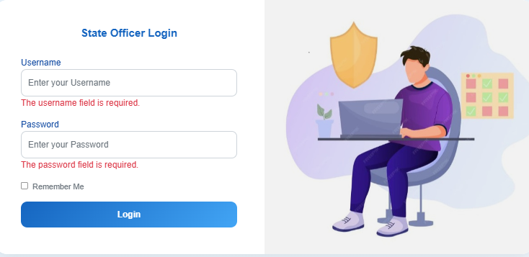
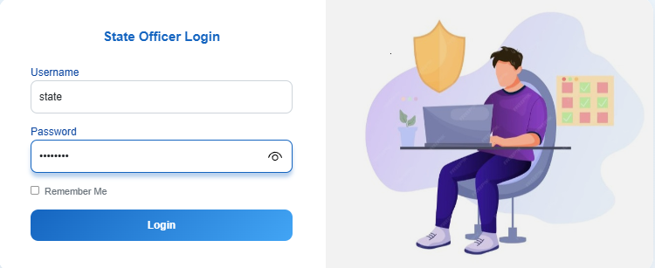
STATE LOGIN
Validations Errors
Successful registration

Slide 26
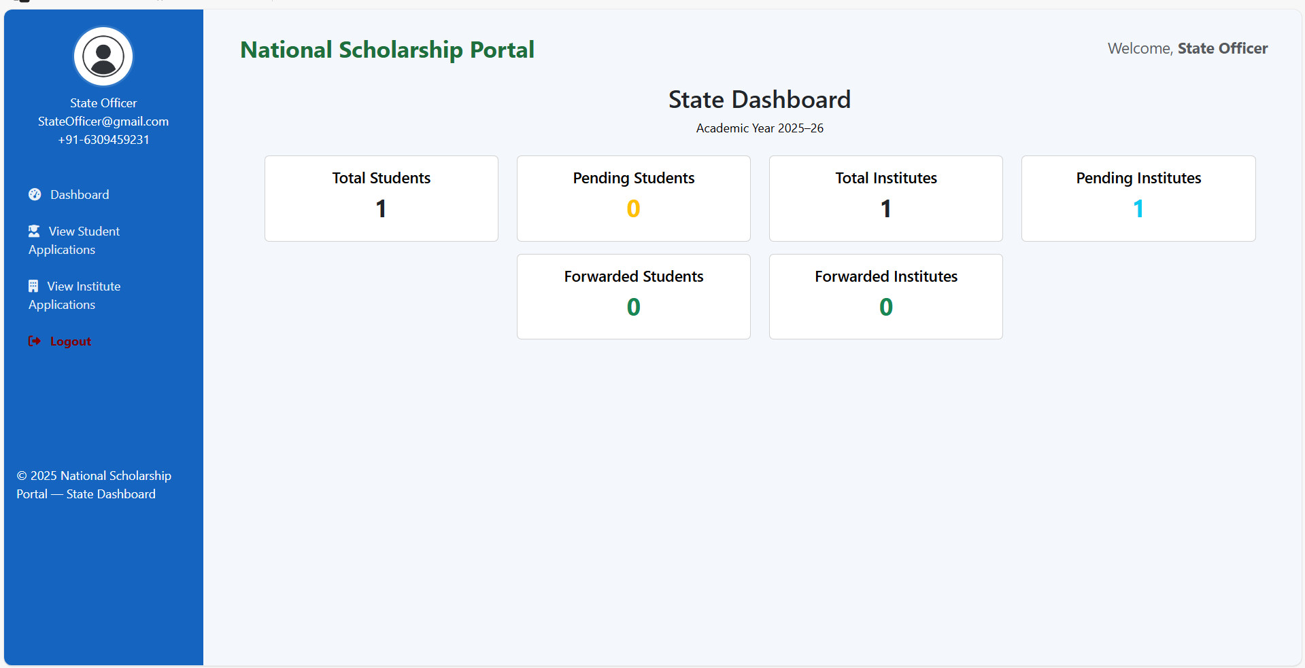
STATE DASHBOARD
The State Dashboard enables state-level authorities to review applications forwarded by institutes. It allows them to verify, approve, or reject applications and then forward the eligible ones to the ministry for final approval. The dashboard provides summaries and helps monitor the overall progress of scholarship distribution within the state.

Slide 27
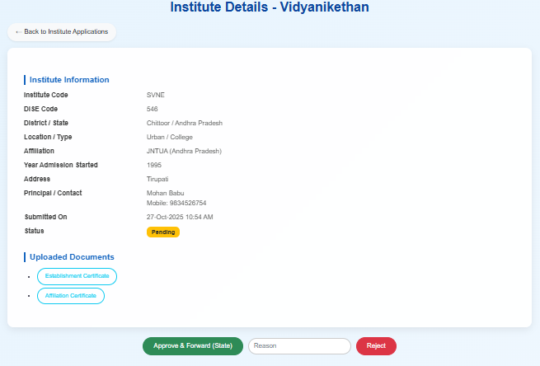
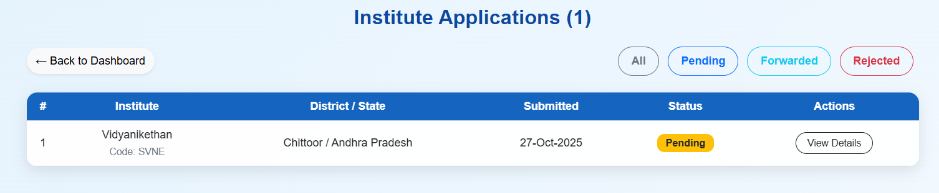
INSTITUTE APPLICATIONS
State can view details of Institute, number of application pending ,Forwarded, rejected and also able to approve or reject.

Slide 28

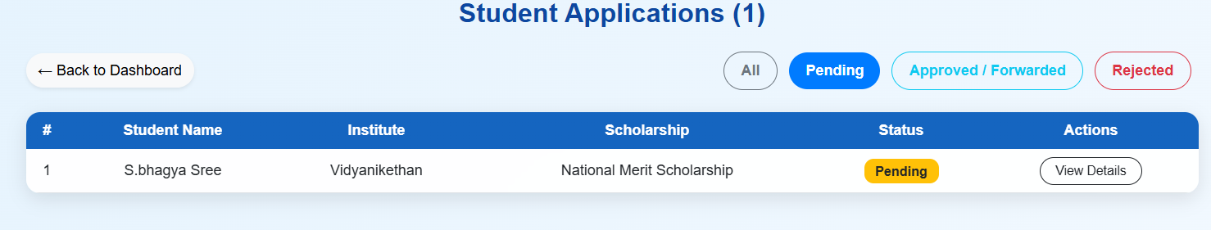
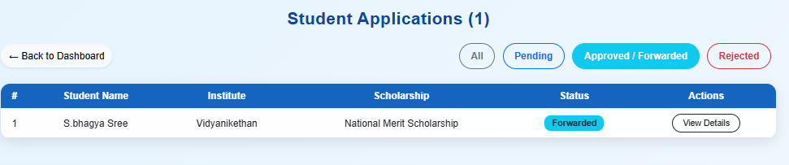
STATE STUDENT APPLICATIONS
State can view details of student, number of application pending ,Approved/Forwarded, rejected and also able to approve or reject.
Fig: Student Application Details

Slide 29


MINISTRY LOGIN
Validations Errors
Successful registration

Slide 30

MINISTRY DASHBOARD
The Ministry Dashboard serves as the final level of verification in the scholarship approval process. It allows ministry officials to review applications forwarded by the states, make final decisions, and approve eligible students for scholarship disbursement. The dashboard also provides a summary of total applications received, approved, and rejected, ensuring transparency and efficient monitoring at the national level.

Slide 31


MINISTRY INSTITUTE APPLICATIONS
Ministry can view details of Institute, number of application pending ,Forwarded, rejected and also able to approve or reject.

Slide 32



MINISTRY STUDENT APPLICATIONS
Ministry can view details of student, number of application pending ,Approved, rejected and also able to approve or reject.
Fig: Student Application Details

Slide 33


